Slide 1

Groundwater Availability Modeling (GAM) Program
Purpose: to develop tools that can be used to help Groundwater Conservation Districts, Regional Water Planning Groups, and others understand and manage their groundwater resources.
Public process: you get to see how the model is put together.
Freely available: models are standardized, thoroughly documented. Reports available over the internet.
Living tools: periodically updated.

Slide 2
What is Groundwater Availability?
Groundwater
Availability
Policy
Science
Desired
Future
Conditions
GAM
or other
tool
Modeled Available Groundwater
Goal: informed decision-making

Slide 3
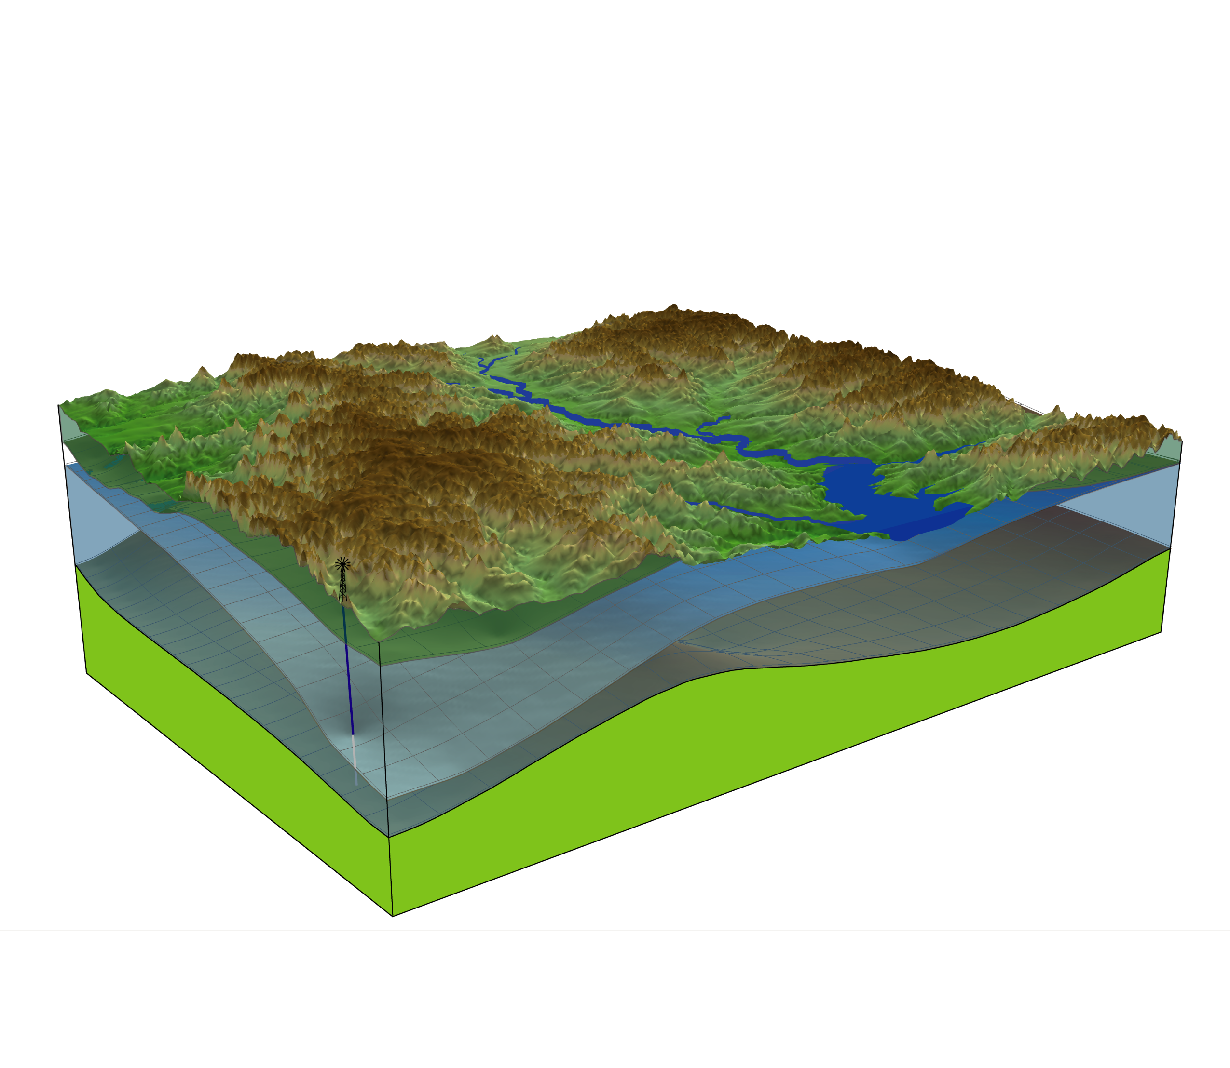
Groundwater Model

Slide 4
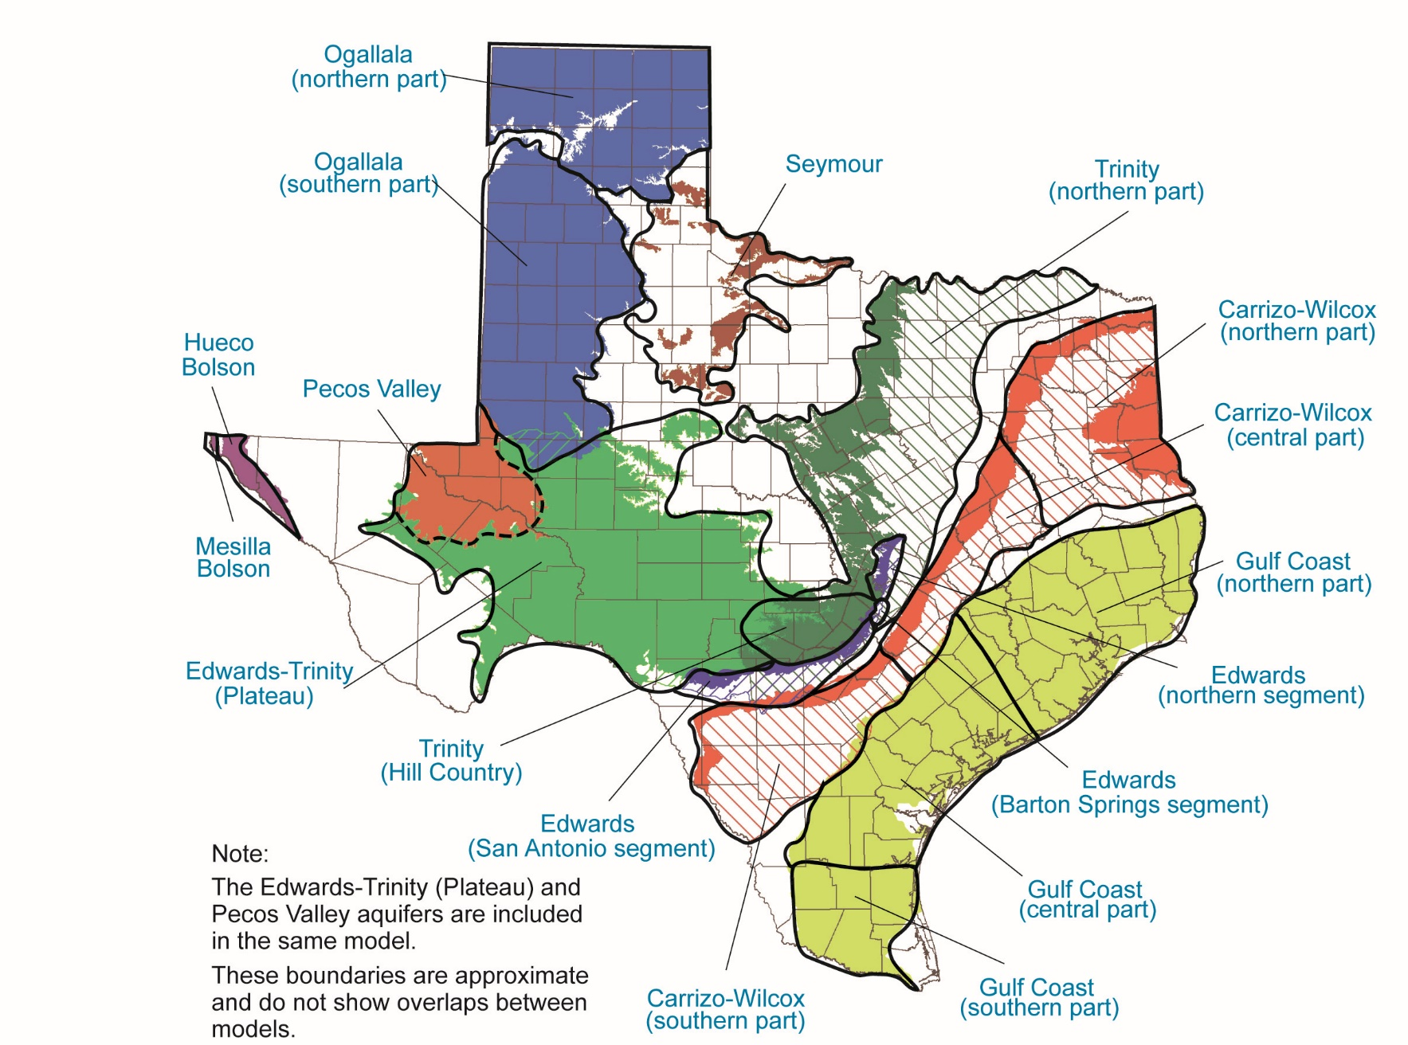
Major Aquifers

Slide 5
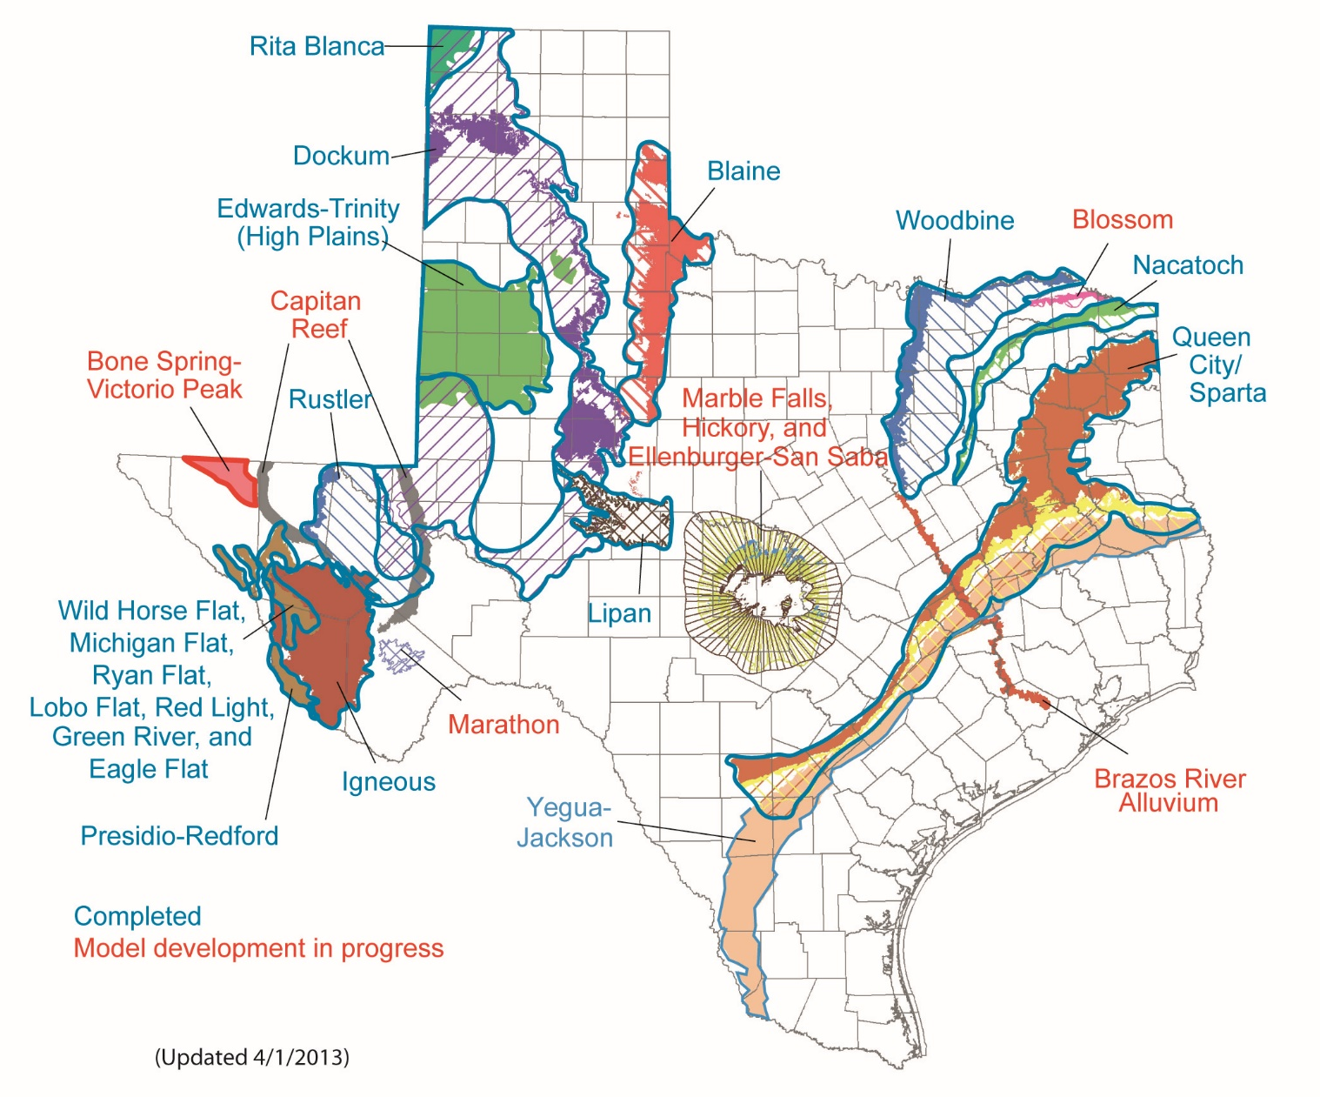
Minor Aquifers

Slide 6
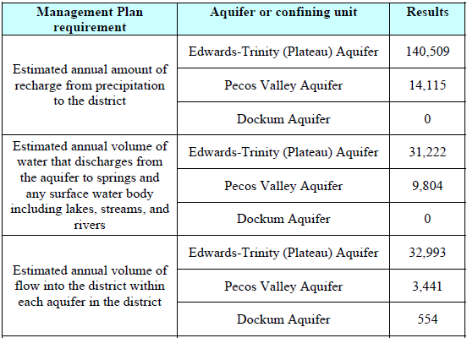
How we use Groundwater Models
Texas Water Code, § 36.1071 (h)
Inform groundwater districts about historical conditions in the aquifer

Slide 7
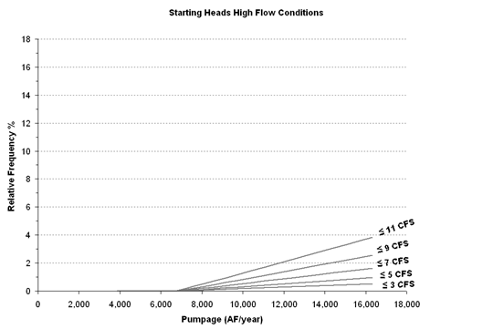
How we use Groundwater Models
Texas Water Code, § 36.108 (d): Assist districts and management areas in determining desired future conditions
Water Levels
Storage
Spring flow

Slide 8
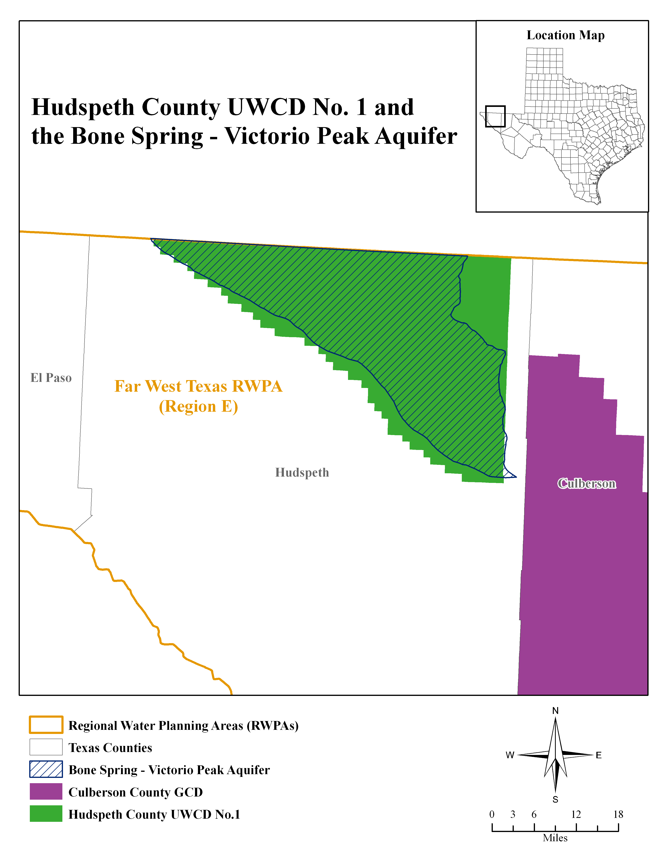
How we use Groundwater Models
Texas Water Code, § 36.1084 (b): Develop modeled available groundwater based on desired future conditions

Slide 9
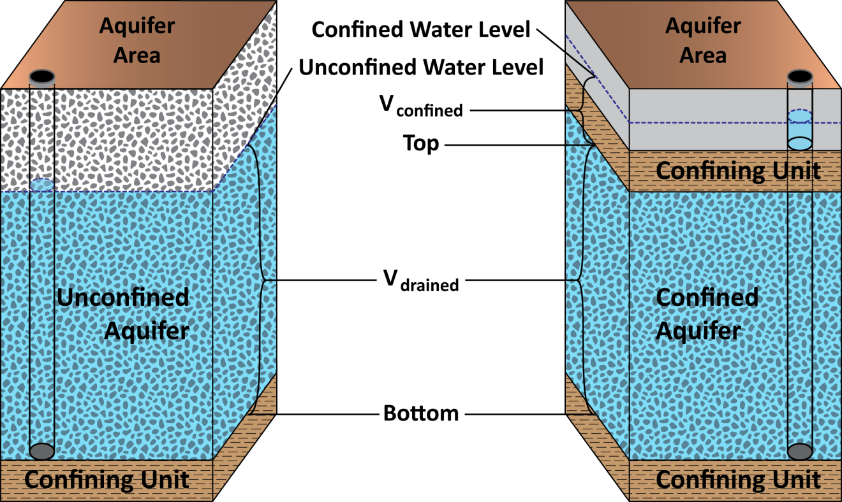
How we use Groundwater Models
Texas Water Code, § 36.108 (d) (3)
Estimating total recoverable storage for explanatory reports

Slide 10
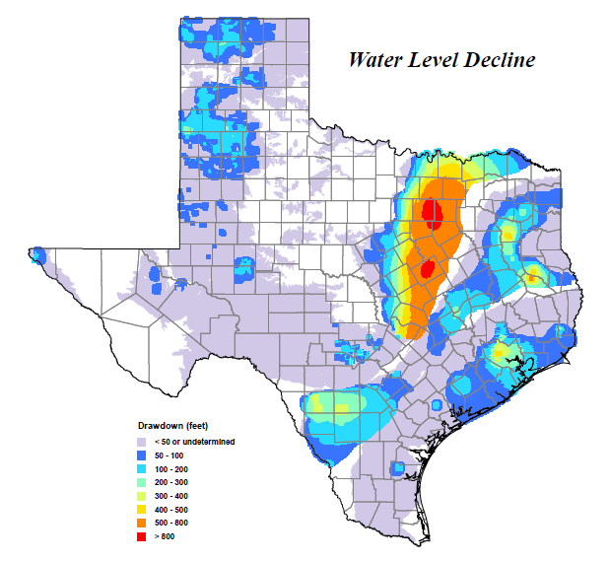
Specific Yield vs. Storativity
Source: TWDB
Notes:
TWDB Water Use Survey indicates 6.5 million acre-feet of pumping in the Ogallala in 2008. That compares to 184,000 acre-feet of pumping in the Trinity Aquifer for the same year.

